Slide 1
LATENT CONSISTENCY MODELS: SYNTHESIZING HIGH-RESOLUTION IMAGES WITH FEW-STEP INFERENCE
Luo et al.
Presented by Dazhen Chen, Nov. 13th, 2024

Slide 2
Background and Motivation
Current Problems:
Diffusion models have achieved remarkable results in image generation
Key limitation: slow generation due to iterative sampling process (typically 50-1000 steps)
Particularly challenging for high-resolution images
Need for faster inference while maintaining quality

Slide 3
Background and Motivation
Previous Approaches
Accelerating through improved ODE solvers
Distillation techniques
Consistency Models as a promising direction
Gap: No efficient solution for high-resolution guided generation

Slide 4
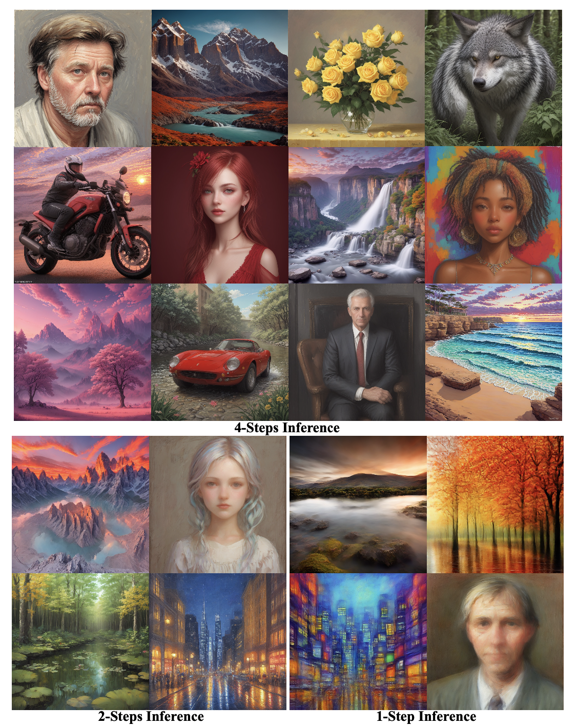
Latent Consistency Model
fast, high-resolution image generation
one-stage guided distillation method
Latent Consistency Fine-tuning

Slide 5
Key Concepts and Foundations
Diffusion Models Primer
Forward process: gradually adding noise
Reverse process: denoising through multiple steps
Probability Flow ODE (PF-ODE):

Slide 6
Key Concepts and Foundations
Classifier-Free Guidance (CFG)
Combines conditional and unconditional predictions
Crucial for high-quality generation
Augmented noise prediction:

Slide 7
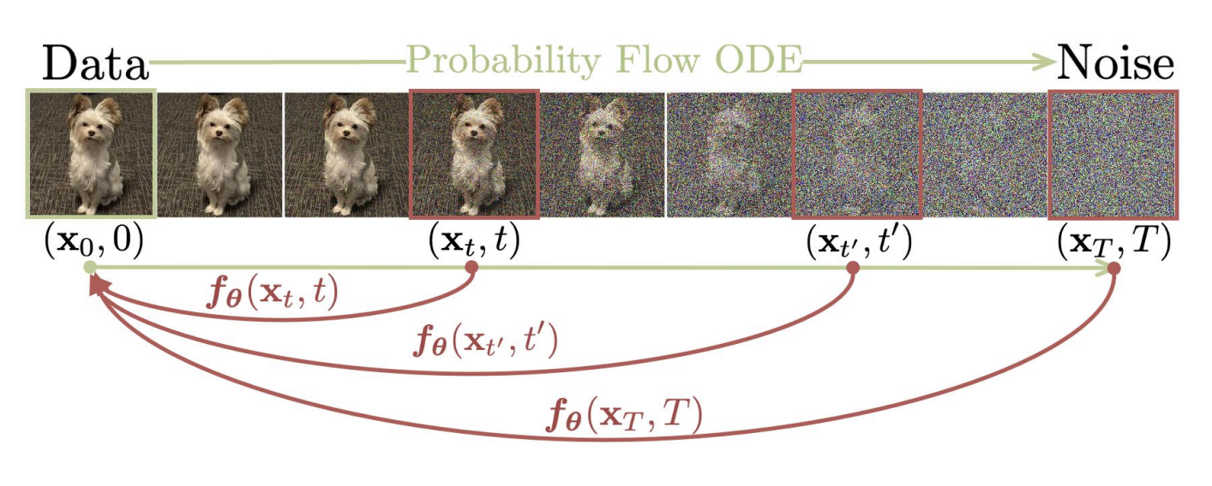
Consistency Model By Song et al.
Enable one-step or few-step generation
Based on learning consistency mappings on ODE trajectories
Direct prediction of denoised samples

Slide 8
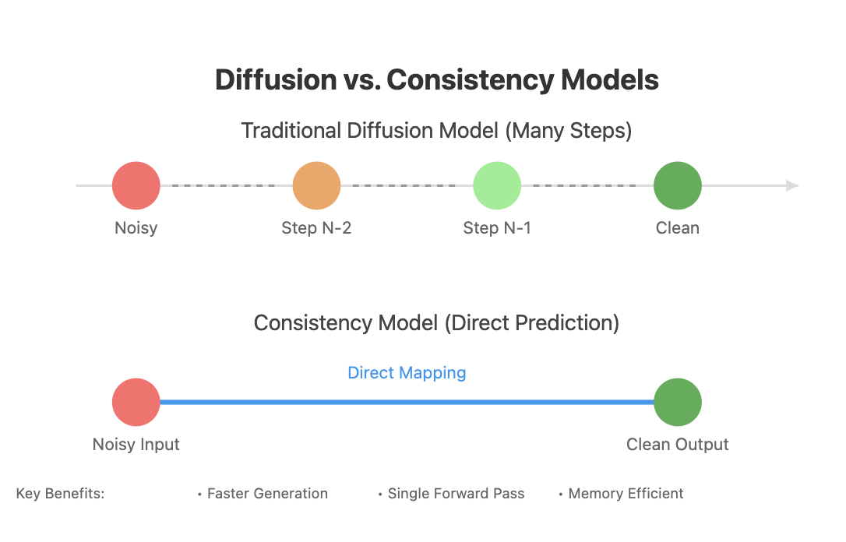

Slide 9
Novel Contributions
Latent Space Consistency
Operates in compressed latent space like Stable Diffusion
Consistency function maps any point to trajectory’s origin:
Notes:
Key Changes:
Input space: x (pixel) → z (latent)
Added condition c for text guidance
Modified network output for latent space
Introduced α_t, σ_t scaling factors
Effect:
Enables latent space operations
Supports conditional generation
Maintains consistency in compressed space

Slide 10
Novel Contributions
One-Stage Guided Distillation
Direct distillation with guidance, no two-stage process needed
Novel augmented PF-ODE incorporating CFG:
Where
Notes:
Key Changes:
Incorporated guidance scale ω
Added conditional/unconditional combination
Modified for latent space dynamics
Effect:
Enables one-stage guided distillation
Controls generation quality through ω
Maintains stable trajectory in latent space

Slide 11
Novel Contributions
Skipping-Step Technique
Accelerates convergence by ensuring consistency across larger time gaps
Modified consistency loss:
Notes:
Key Changes:
Introduced skip interval k (typically 20)
Modified consistency loss for larger steps
Adapted ODE solver estimation
Effect:
Accelerates convergence
Reduces training iterations
Maintains generation quality

Slide 12
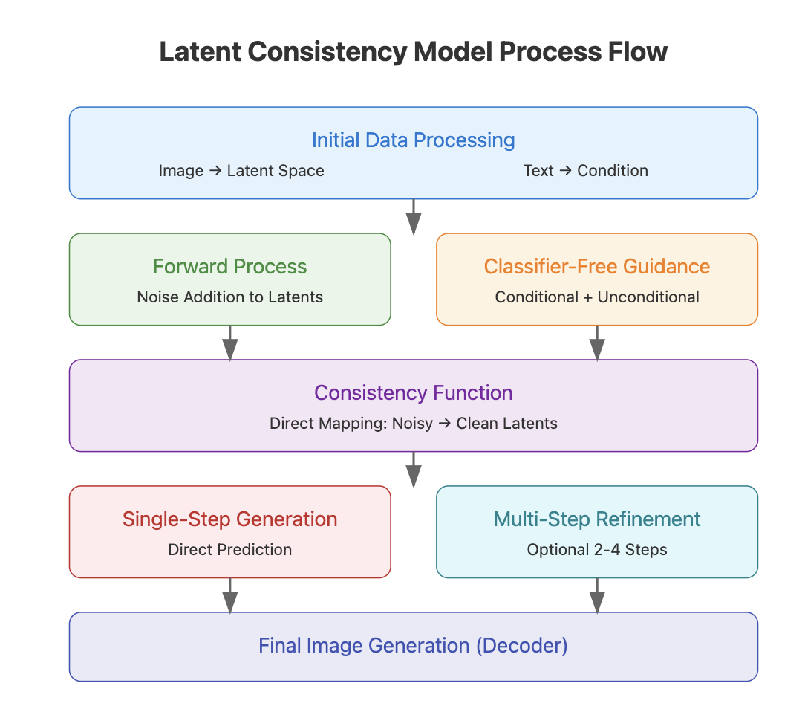
How does it work

Slide 13
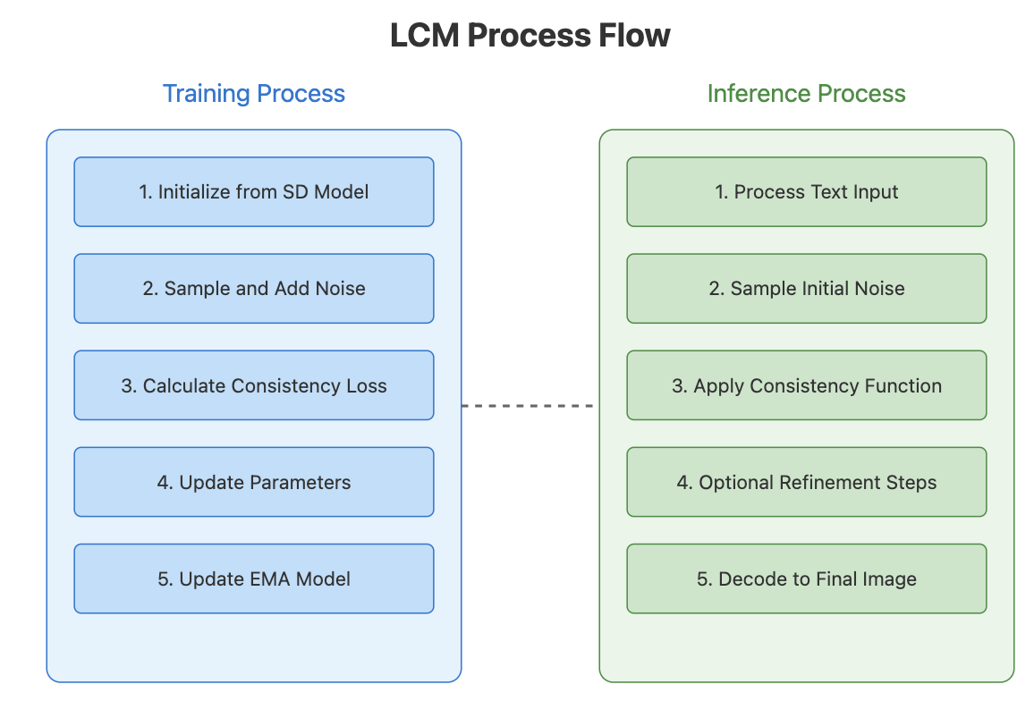
How does it work

Slide 14
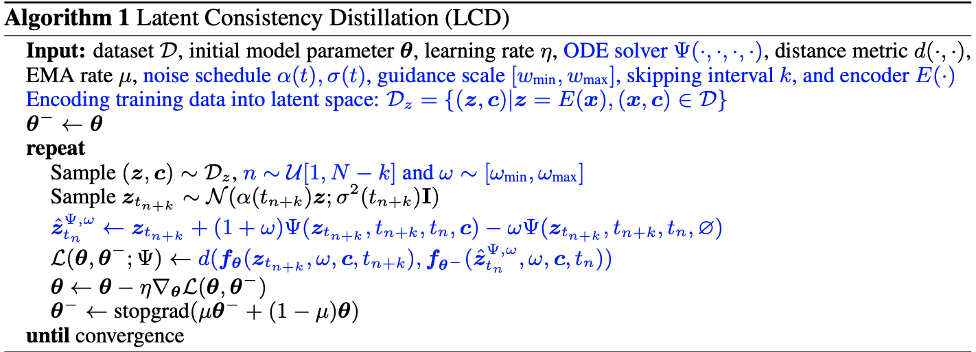
Algorithm Pseudocode

Slide 15
Latent consistency Fine Tuning
enables efficient few-step inference on customized datasets
No teacher diffusion model trained on such data needed
Randomly select two time steps t_n and t_n+k and apply same ε
calculate the consistency loss for these two time steps to enforce self- consistency property

Slide 16
Validation
Performance Metrics
State-of-the-art results in 2-4 step inference
Significantly better FID scores and CLIP scores
Only 32 A100 GPU hours for training

Slide 17
Validation
Experiment Setup
LAION-Aesthetics-6+ (12M) and LAION-Aesthetics-6.5+ (650K)
pre-trained Stable Diffusion-V2.1-Base as teacher model
train LCM with 100K iterations and we use a batch size of 72 for (512 × 512) setting, and 16 for (768 × 768) setting

Slide 18
Validation
Baseline and Evaluation
DDIM, DPM, DPM++, and Guided-Distill as baselines
pre-trained Stable Diffusion-V2.1-Base as teacher model
train LCM with 100K iterations and we use a batch size of 72 for (512 × 512) setting, and 16 for (768 × 768) setting

Slide 19
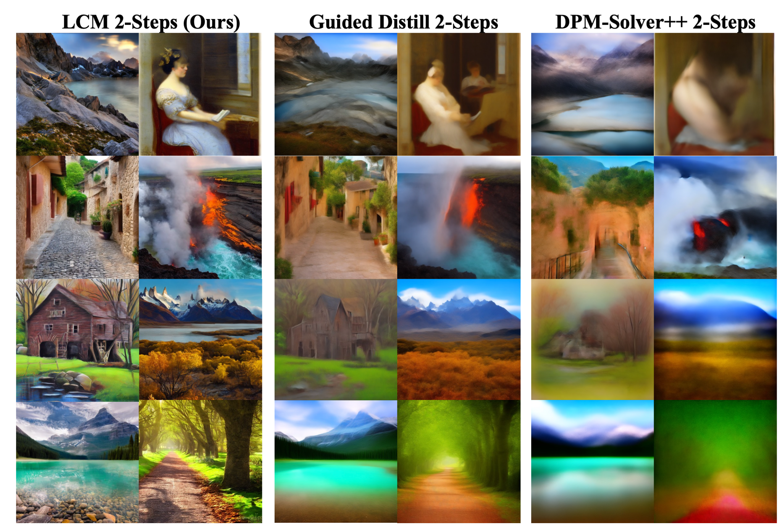
Result

Slide 20
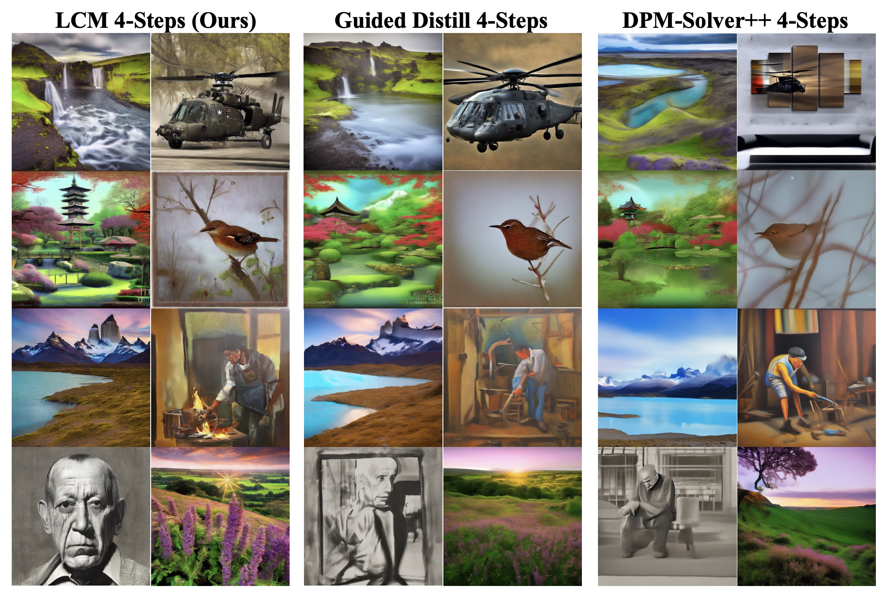
Result

Slide 21
Effect of different Solve Ψ

Slide 22
Effect of Guidance Scale ω

Slide 23
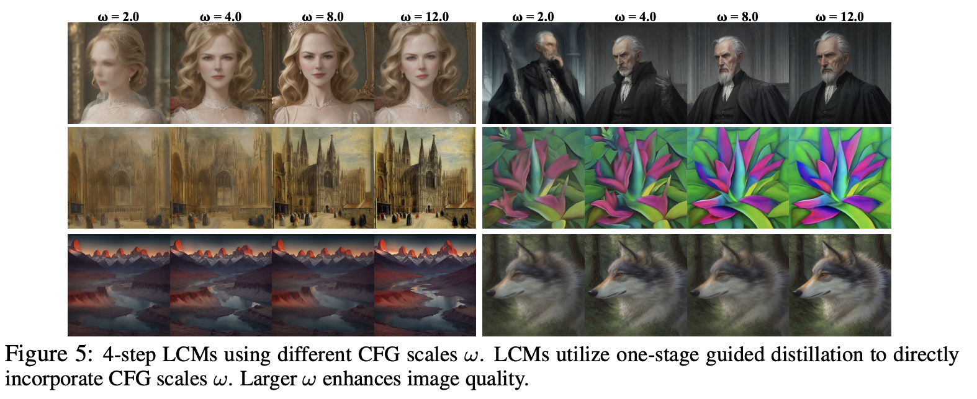
Result

Slide 24
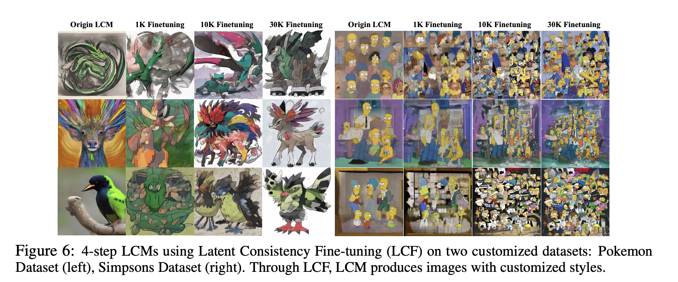
Latent Consistency Fine-tuning result

Slide 25
Pros
Fast few-step inference
High-quality outputs
Efficient training process
Memory efficient

Slide 26
Cons
One-step generation quality gap
Potential for text-guided editing
Applications to other domains

Slide 27
Future Improvement
Memory Optimization
Training Efficiency
Text-Guided Image Editing
Multi-modal extensions

